Slide 1
Comparative Analysis of Naïve Bayes, KNN, and Decision Tree Algorithms in Disaster Prediction

Slide 2
Problem Definition
Natural disasters such as floods, typhoons, landslides, and earthquakes continue to affect many communities, causing damage to property, disruption of livelihoods, and loss of lives.
With the increasing availability of disaster-related data, machine learning algorithms have become useful tools for analyzing patterns and predicting potential risks.
Algorithms such as Naïve Bayes, K-Nearest Neighbors (KNN), and Decision Tree are commonly used for classification and prediction tasks.

Slide 3
Mathematical and Computational Mode
Algorithms: Naïve Bayes, KNN, and Decision Tree
Used to predict simulation of a disaster
Dataset Features
Naïve Bayes
Cloud Density → Low=1, Medium=2, High=3
Humidity → Low=1, Medium=2, High=3
Rainfall (Typhoon) → Light=1, Moderate=2, Heavy=3
Wind Speed → Weak=1, Moderate=2, Strong=3
Typhoon Warning → No=0, Yes=1
KNN
Rainfall Intensity → Very Light=1, Light=2, Moderate=3, Heavy=4, Very Heavy=5
Water Level → Below ankle=1, Knee=2, Waist=3, Chest=4, Above chest=5
Wind Strength → Weak=1, Moderate=2, Strong=3, Very Strong=4
Flood Risk → Low=1, Medium=2, High=3
Decision Tree
Rainfall (Disaster) → Light=1, Moderate=2, Heavy=3
River Overflow → No=0, Yes=1
Soil Condition → Stable=2, Weak=1
Wind Intensity → Weak=1, Moderate=2, Strong=3
Disaster Severity → Low=1, Moderate=2, Severe=3

Slide 4

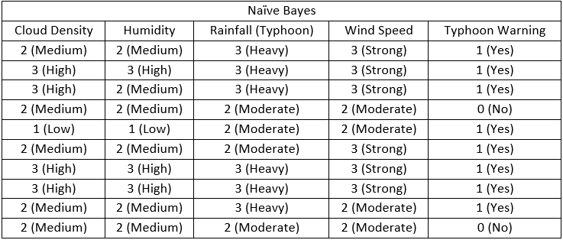
Naïve Bayes
Features Used: Cloud Density, Humidity, Rainfall, Wind Speed → Typhoon Warning
Formula:
Example:

Slide 5
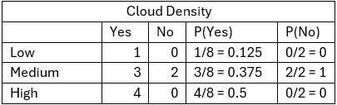
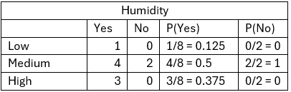
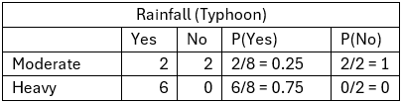

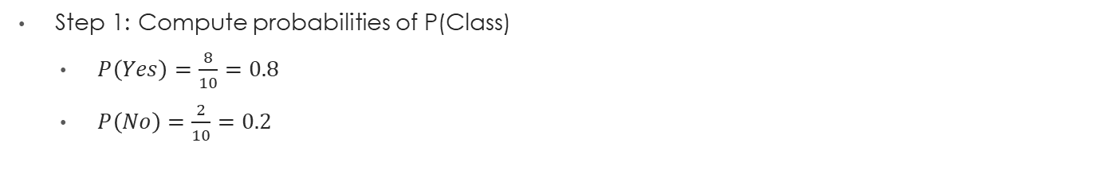
Naïve Bayes
Test Instance:
Cloud Density = 2(Medium)
Humidity = 3 (High)
Rainfall = 3 (Heavy)
Wind Speed = 3 (Strong )
Step 1: Compute probabilities of P(Class)
$P\left(Yes\right)=\frac{8}{10}=0.8$
$P\left(No\right)=\frac{2}{10}=0.2$
Step 2: Compute likelihoods of P(Feature|Class)

Slide 6
Naïve Bayes
Step 3: Multiply them together
Sample 1 (Medium, Medium, Heavy, Strong → Yes):
P(Yes) = 0.375 * 0.5 * 0.75 * 0.75 = 0.11
P(No) = 1 * 1 * 0 * 0 = 0
Step 4: Normalize Results
Test Instance (Medium, High, Heavy, Strong ):
P(Yes) = 0.375 * 0.375 * 0.75 * 0.75 = 0.08
P(No) = 1 * 0 * 0 * 0 = 0
Final Prediction:
Since 0.08 > 0, the predicted output for test instance (Medium, High, Heavy, Strong ) is Typhoon Warning = “Yes”.

Slide 7
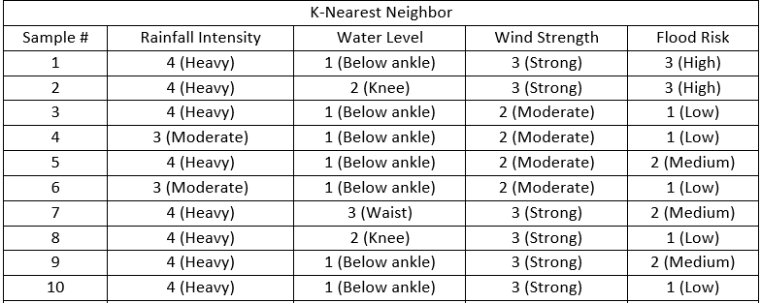
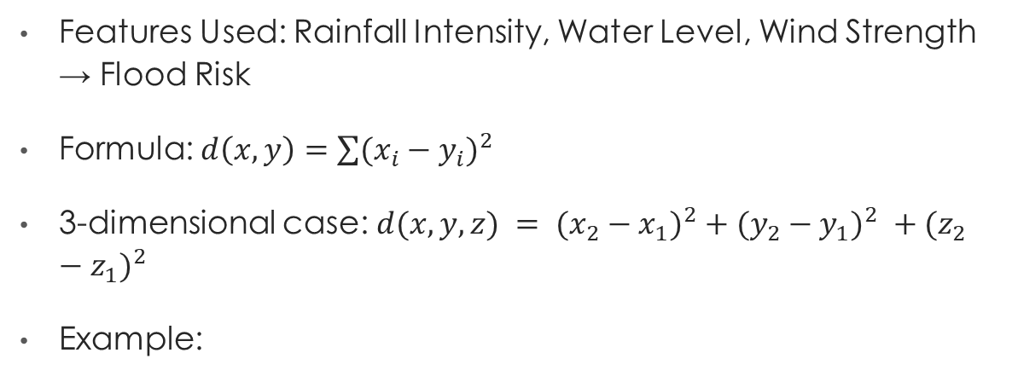
K-Nearest Neighbors (KNN)
Features Used: Rainfall Intensity, Water Level, Wind Strength → Flood Risk
Formula: $d\left(x,y\right)=\sum{(x_{i}−y_{i})^{2}}$
3-dimensional case: $d(x,y,z) = (x_{2}−x_{1})^{2}+(y_{2}−y_{1})^{2} +(z_{2}−z_{1})^{2}$
Example:

Slide 8
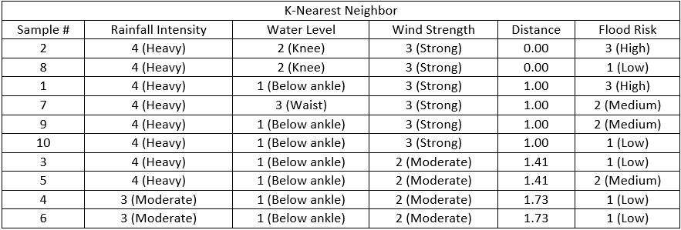

K-Nearest Neighbors (KNN)
Test Instance:
Rainfall Intensity = 4 (Heavy) (x)
Water Level = 2 (Knee) (y)
Wind Strength = 3 (Strong) (z)
Step 1: Compute a few distances manually using the 3 – dimensional case
Sample 1 (4, 1, 3 → High):
$d=\sqrt{(4−4)^{2}+(2−1)^{2}+(3−3)^{2}}= \sqrt{1}$ = 1
Step 2: Distance Summary table (Ascending Order)

Slide 9
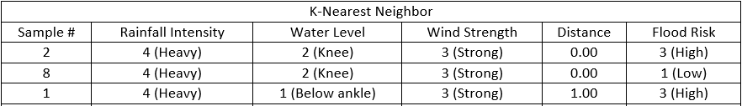
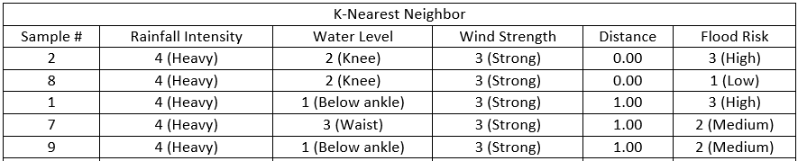
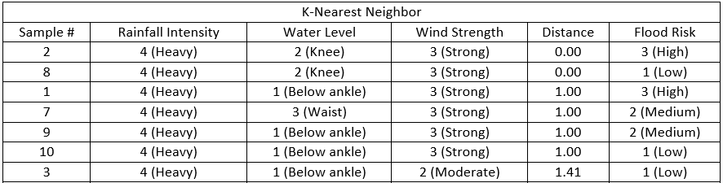
K-Nearest Neighbors (KNN)
Step 3: KNN Voting
K = 3
K = 5
For the test instance (Rainfall Intensity = Heavy, Water Level = Knee, Wind Strength = Strong), the KNN model predict: Flood Risk = “High”
K =7

Slide 10

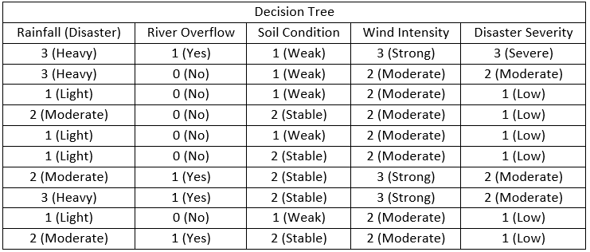
Decision Tree
Features Used: Rainfall, River Overflow, Soil Condition, Wind Intensity → Disaster
Formula (Informatin Gain):
Example:

Slide 11
Decision Tree
Test Instance:
Rainfall = 3 (Heavy)
River Overflow = 1 (Yes)
Soil Condition = 1 (Weak)
Wind Intensity = 3 (Strong)
Step1: Calculate Entropy of dataset
P(Low)=6/10=0.6
P(Moderate)=3/10=0.3
P(Severe)=1/10=0.1
Entropy(S) = 1.296
Step2: Compute Information Gain for each feature
Rainfall: 0.745
River Overflow: 0.306
Soil Condition: 0.126
Wind Intensity: 0.606

Slide 12
Decision Tree
Step 3: Split on the feature with the highest gain
Rainfall (Disaster) has the highest gain of 0.745. So, the root node of the decision tree is Rainfall.
Step 4:Follow decision path
If Rainfall = Low → Low Severity
If Rainfall = Moderate → Moderate Severity
If Rainfall = Heavy → check River Overflow
If Rainfall = Very Heavy → Severe Severity
After computing entropy and information gain, the results show that Rainfall (IG = 0.745) is the most influential feature.

Slide 13
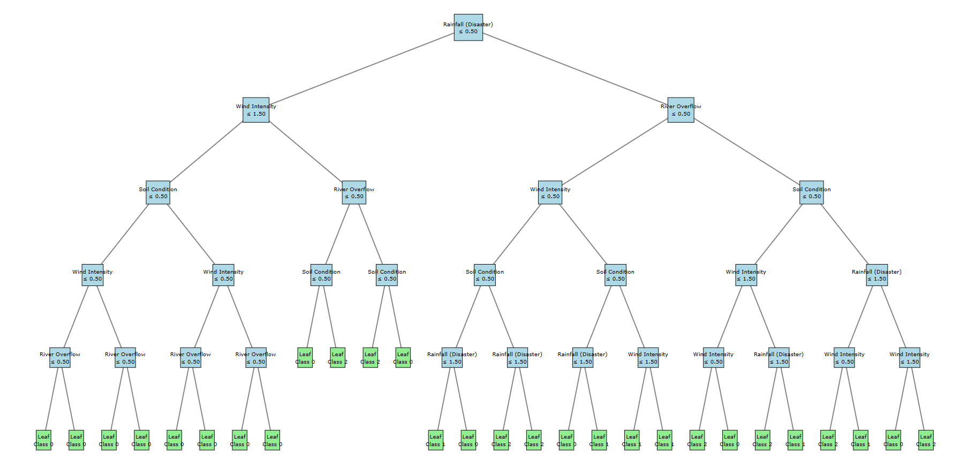
Decision Tree
Decision Tree with 1000 datasets:

Slide 14
Implementation and Experimentation
1. Dataset Preparation
The dataset contained multiple disaster-related features such as rainfall intensity, water level, wind strength, soil condition, cloud density, humidity, and early warning system reception. Each categorical variable was systematically converted into numerical values (e.g., Heavy Rainfall = 4, Knee-level Water = 2, Strong Wind = 3).
2. Preprocessing
Missing values handling: Incomplete or inconsistent survey entries were handled by either imputing missing values using the median or removing records with invalid/inconsistent responses (depending on the nature of the missingness).
Feature scaling: Min–Max normalization was applied only for KNN to rescale the continuous/numeric inputs between 0 and 1.
Train–test split: The dataset was divided into 80% training data and 20% testing data.
3. Model Training
Naïve Bayes: Implemented as a probabilistic classifier using Bayes’ Theorem. Prior probabilities and likelihoods were computed from the training set to predict Typhoon Warning (Yes/No).
KNN: Implemented using Euclidean distance as the similarity measure. The model tested multiple values of kkk (k = 3, 5, 7) to analyze how neighborhood size affects prediction of Flood Risk (Low/Medium/High).

Slide 15
Implementation and Experimentation
Decision Tree: Constructed using Information Gain (Entropy) as the splitting criterion. The tree classified Disaster Severity (Low/Moderate/Severe) using the selected features: rainfall, river overflow, soil condition, and wind intensity. Scaling was not applied because the Decision Tree method relies on rule-based splits rather than distance metrics.
4. Dataset Preparation
Naïve Bayes predicted Typhoon Warning = Yes/No
KNN predicted Flood Risk = Low/Medium/High
Decision Tree predicted Disaster Severity = Low/Moderate/Severe
5. Evaluation
Naïve Bayes → Achieved 59.0% accuracy in predicting Typhoon Warning.
KNN → Accuracy varied depending on the value of k:
k = 3 → 49.0%
k = 5 → 49.0%
k = 7 → 52.33%
The best performance was observed at k = 7, which was selected as the optimal KNN setting.
Decision Tree → Reached 45.0% accuracy in predicting Disaster Severity.

Slide 16
Implementation and Experimentation
4. Visualization
Bar charts/tables comparing the accuracy of the three algorithms.
Confusion matrices (where generated) to show misclassifications and error patterns for each model, providing deeper insight into model behavior beyond overall accuracy.

Slide 17
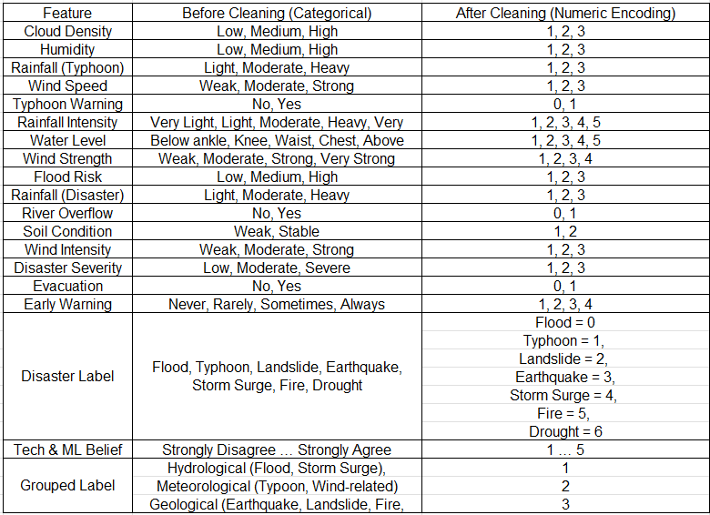
Visualization and Analysis
Preprocessing Comparison
In the preprocessing stage, categorical disaster-related attributes were transformed into numeric encodings to make the dataset suitable for machine learning models.

Slide 18
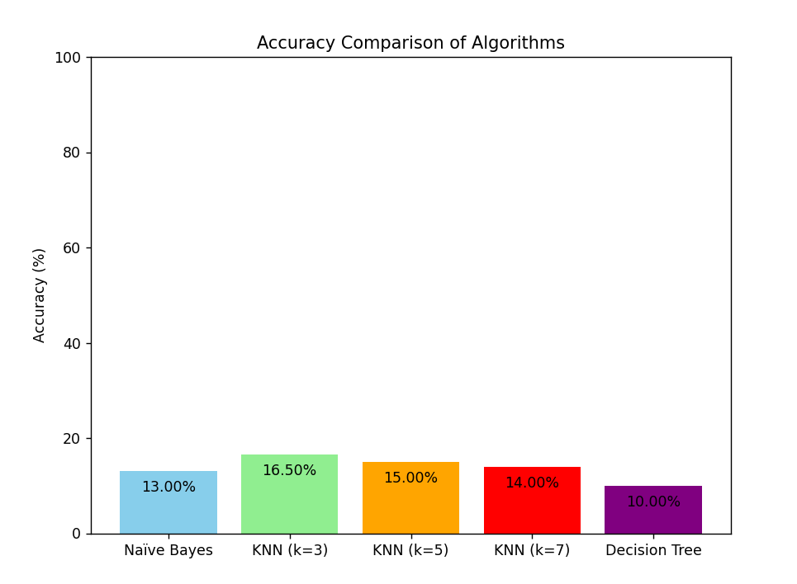
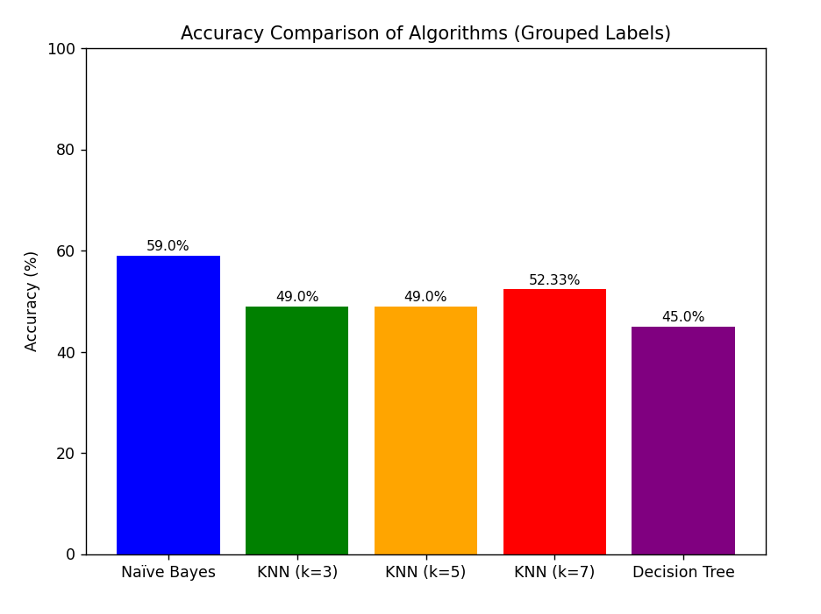
Visualization and Analysis
Accuracy Comparison
Without Grouped Label
With Grouped Label
The accuracy comparison illustrates the performance of different machine learning algorithms in classifying disasters into Hydrological, Meteorological, and Geological groups. Among the tested models, Naïve Bayes achieved the highest accuracy (59.00%), while KNN variants ranged between 49.00%–52.33%, and Decision Tree reached 45.00%.

Slide 19
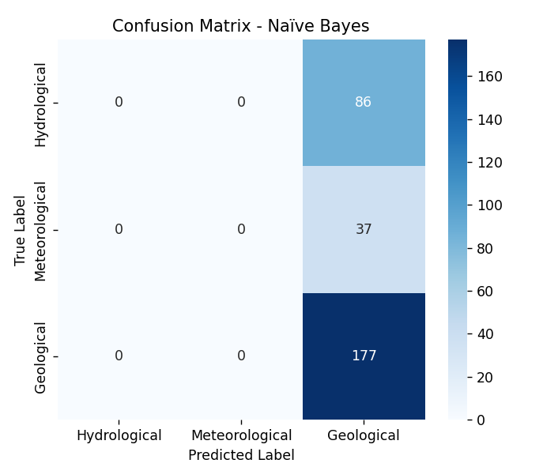
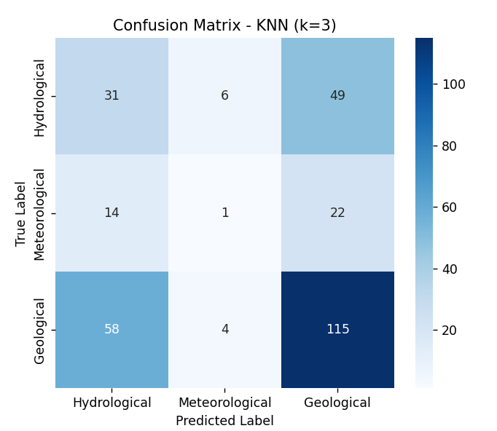
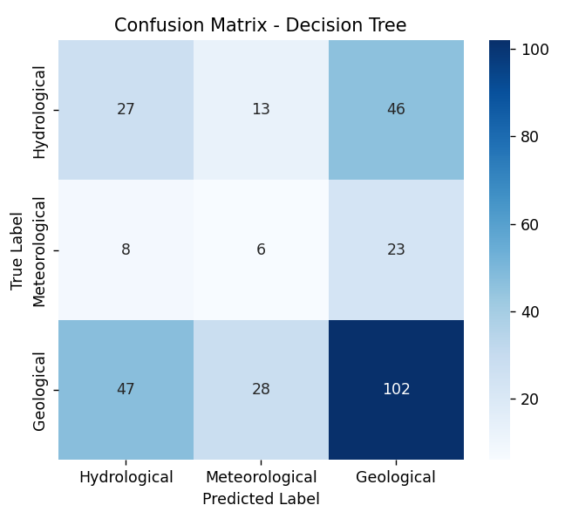
Visualization and Analysis
Confusion Matrix
Naïve Bayes → Predicted almost all samples as Geological, showing strong bias and poor separation of categories. This explains why its confusion matrix is heavily skewed.
KNN (k=3) → Distributed predictions more evenly, correctly identifying some Hydrological and Meteorological cases, but still misclassifying many into Geological. This shows KNN can capture local patterns but struggles with overlapping features.
Decision Tree → Achieved a more balanced classification, correctly predicting across all three groups, though misclassifications remain. Its structure allows it to split based on feature thresholds, giving clearer decision boundaries compared to Naïve Bayes.

Slide 20
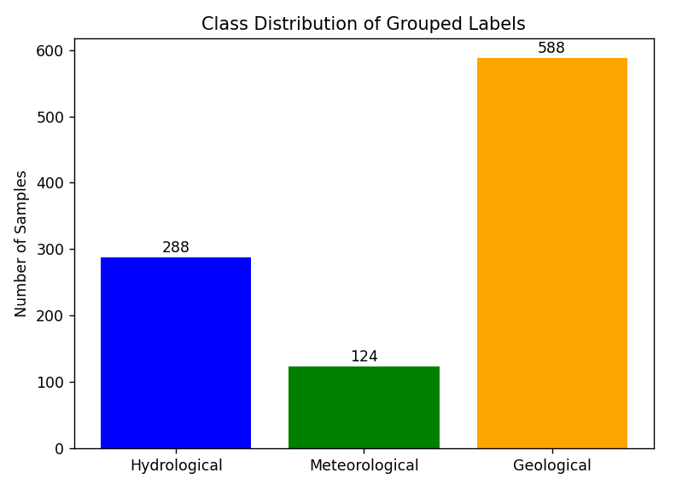
Visualization and Analysis
Class Distribution Chart
The class distribution chart shows that the dataset is imbalanced, with Geological disasters (588 samples) being the most frequent, followed by Hydrological (288 samples) and Meteorological (124 samples).

Slide 21
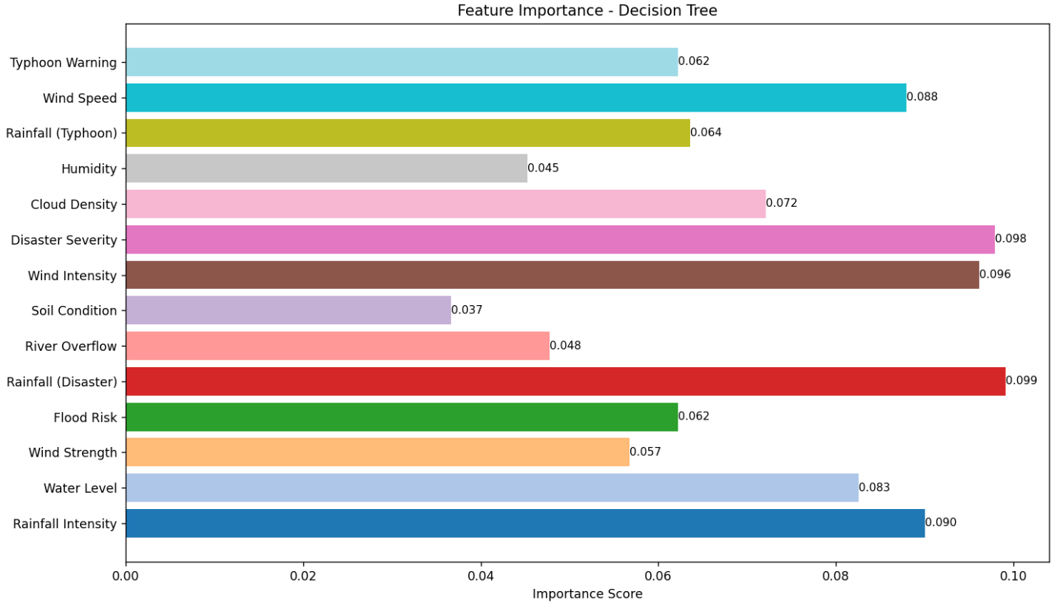
Visualization and Analysis
Feature Importance (Decision Tree)
The feature importance chart shows that Rainfall (Disaster), Disaster Severity, Wind Intensity, and Rainfall Intensity are the most influential variables in the Decision Tree model, each with relatively higher importance scores.

Slide 22
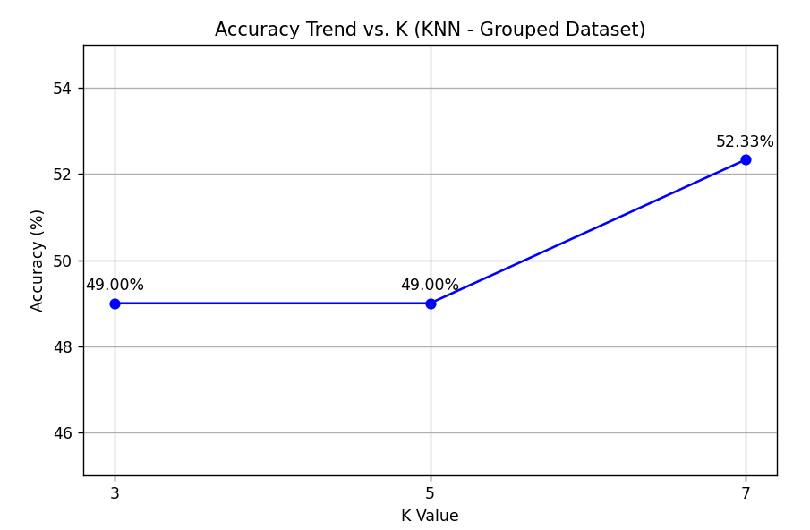
Visualization and Analysis
Accuracy Trend vs K (for KNN)
The accuracy trend vs. k shows that KNN performance remained stable at 49% for k=3 and k=5, then improved slightly to 52.33% at k=7.

Slide 23
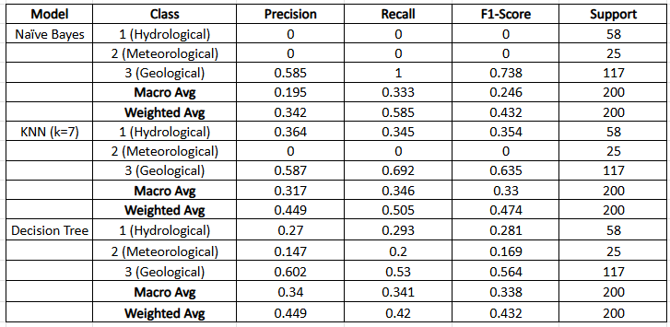
Visualization and Analysis
Evaluation Metrics: Precision, Recall, F1-Score
Naïve Bayes → Completely failed to classify Hydrological and Meteorological disasters (precision/recall = 0) but performed very well on Geological (F1 = 0.738). Its weighted average F1 = 0.432 reflects this imbalance.
KNN (k=7) → Improved recall for Geological (0.692) and gave moderate performance for Hydrological (F1 = 0.354) but still failed on Meteorological (0.000). Weighted F1 = 0.474, slightly better than Naïve Bayes.
Decision Tree → More balanced across classes, with moderate scores for Hydrological (0.281) and Meteorological (0.169), and decent performance on Geological (0.564). Weighted F1 = 0.432, similar to Naïve Bayes but with better distribution across classes.

Slide 24
Summary
Naïve Bayes performed strongly only for Geological disasters but completely failed to classify Hydrological and Meteorological events.
K-Nearest Neighbors (KNN) showed slight improvement, especially in capturing local patterns, which helped its performance for Geological and partly for Hydrological disasters.
The Decision Tree provided the most interpretable results and was the only model that produced predictions for all disaster types.

Slide 25
Thank you
Tangalin, Armie Joy
Palanggalan, Al-hamer
Mantiquilla, Joanah Kate

